Slide 1
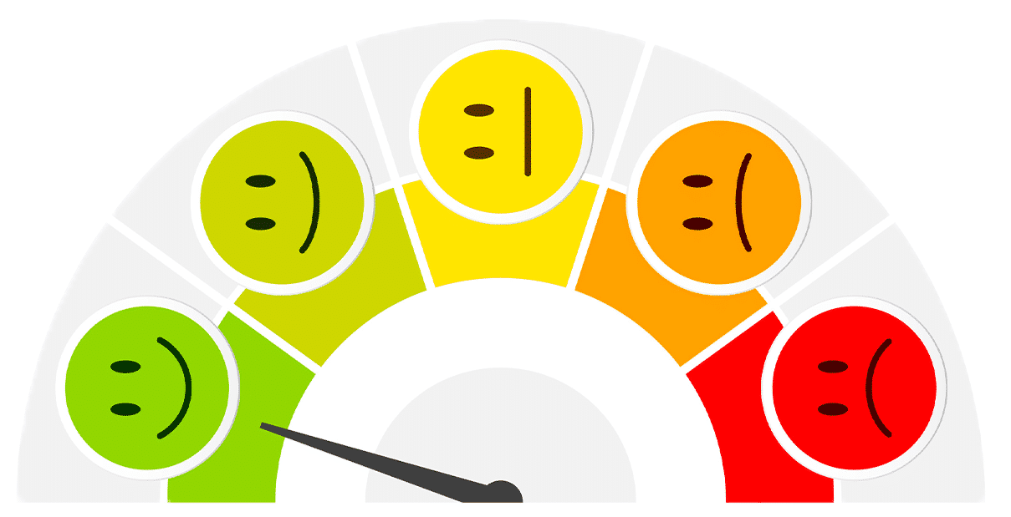
TWITTER SENTIMENT ANALYSIS:
AI IN EDUCATION
By: Jada Ogueh

Slide 2
TABLE OF CONTENTS
01
02
03
RATIONALE
Introducing the need, problem, and solution
STEPS
Explaining data gathering, pre-processing, analyzation, and visualization
RESULTS
Summary and Conclusion

Slide 3
RATIONALE
01.

Slide 4

NEED
Artificial intelligence has become very popular in the past year. Tools like ChatGPT have allowed students to bypass schoolwork, get easy answers, but also deepen their understanding of concepts their schooling may not properly address. There are a number of ways to use A.I. and the school system is divided on how to address this new technology…

Slide 5
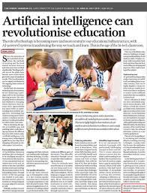

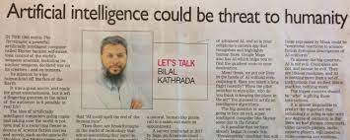

Slide 6
How can we gauge public opinion on AI in education to help guide school policies?

Slide 8
SOLUTION
Create sentiment visualizations based on tweets to show public opinion on A.I. in education. Based on the general opinion, we can give policymakers a better idea on how to handle A.I. integration in schooling. I will use the pandas library in Python to analyze a database full of tweets regarding AI in education.

Slide 9
STEPS
O2.

Slide 10
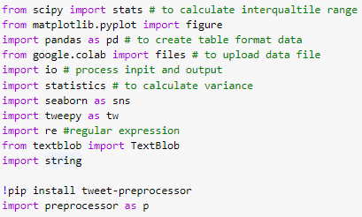
GATHERING THE DATA (1)
01
Import the important libraries as these will allow us to conduct data processing and visualization.

Slide 11
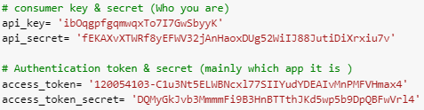
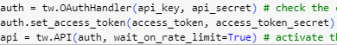
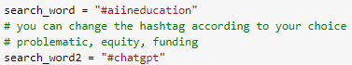
GATHERING THE DATA (2)
02
Set up Twitter API keys and secrets (who I am) and authentication token and secret (the app it is).
03
Activate the Twitter API.
04
Set up my two search queries: #aiineducation and #chatgpt

Slide 12
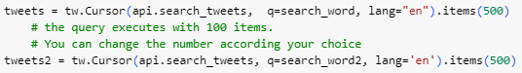



GATHERING THE DATA (3)
05
Request 500 tweets each containing my desired hashtags.
06
Initialize a Pandas DataFrame using the data from each query.
07
Combine the two dataframes into one dataframe, and now I’ve collected my data.

Slide 13

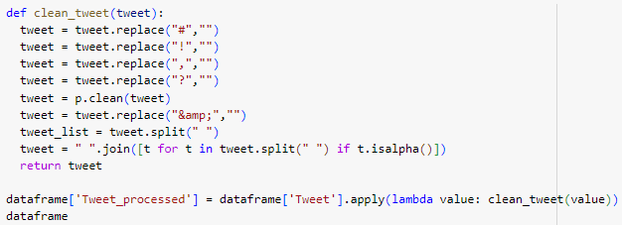
PRE-PROCESSING THE DATA (1)
Delete duplicate tweets and clean up the tweets by removing RT, mentions, and non-alphabetical characters from the tweets

Slide 14
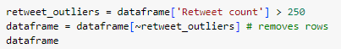
PRE-PROCESSING THE DATA (2)
Removing tweets with a massive amount of retweets as it skews the data.

Slide 15
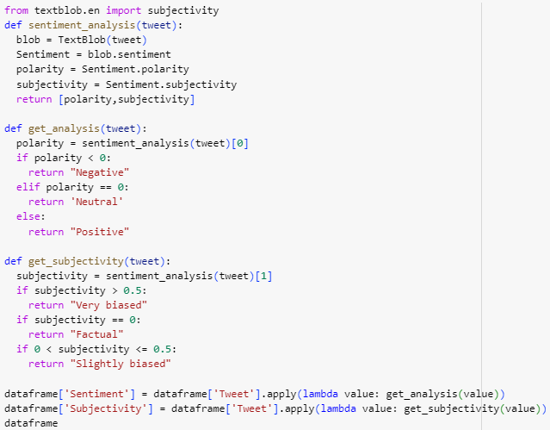
ANALYZING THE DATA (1)
I used the Text Blob library to conduct sentiment and subjectivity analysis on the Tweet column, and saved the results to 2 new columns:
Sentiment
Positive
Negative
Neutral
Subjectivity
Very biased
Slightly biased
Factual
01

Slide 16
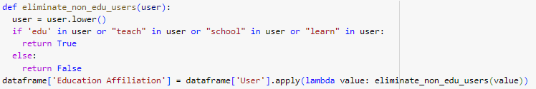
ANALYZING THE DATA (2)
02
I wanted to track the difference in opinions between users that were affiliated with education versus not, so I created a column called Education Affiliation that was True if the username contained keywords related to education such as teach or edu.

Slide 17
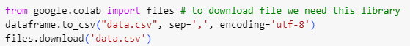
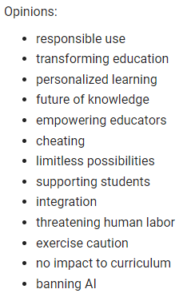
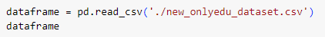
ANALYZING THE DATA (3)
03
I had to download my dataframe as a CSV so I could manually check the validity of my sentiment and subjectivity column, but also add the Opinion column which stated the opinion expressed in a tweet. Afterwards I loaded that CSV into another dataframe.

Slide 18
ANALYZING THE DATA (3)
03
I had to download my dataframe as a CSV so I could manually check the validity of my sentiment and subjectivity column, but also add the Opinion column which stated the opinion expressed in a tweet. Afterwards I loaded that CSV into another dataframe.

Slide 19
RESULTS - VISUALIZATION
O3.

Slide 20
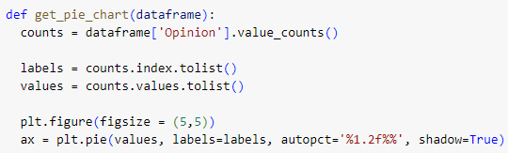
PIE CHART

Slide 21
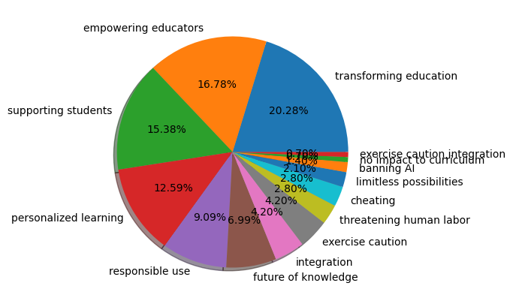
ALL

Slide 22
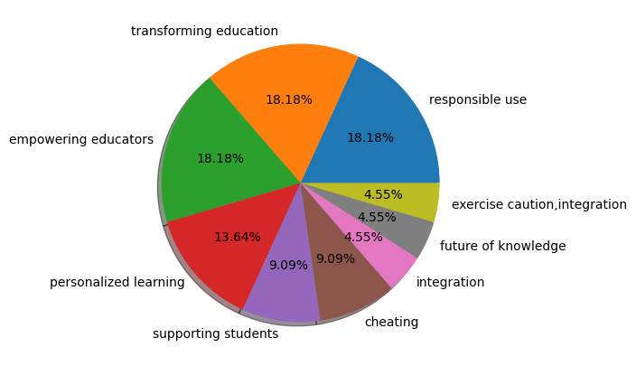
EDUCATION USERS

Slide 23
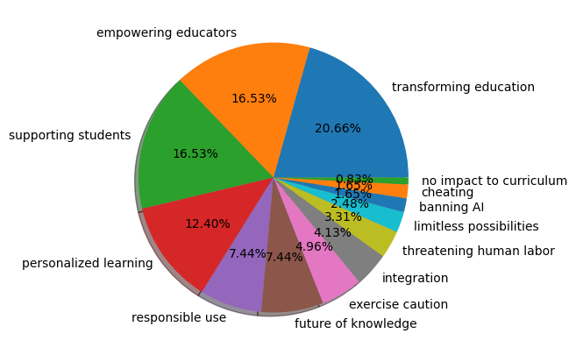
NON EDUCATION USERS

Slide 24
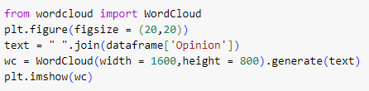
WORD CLOUD

Slide 25
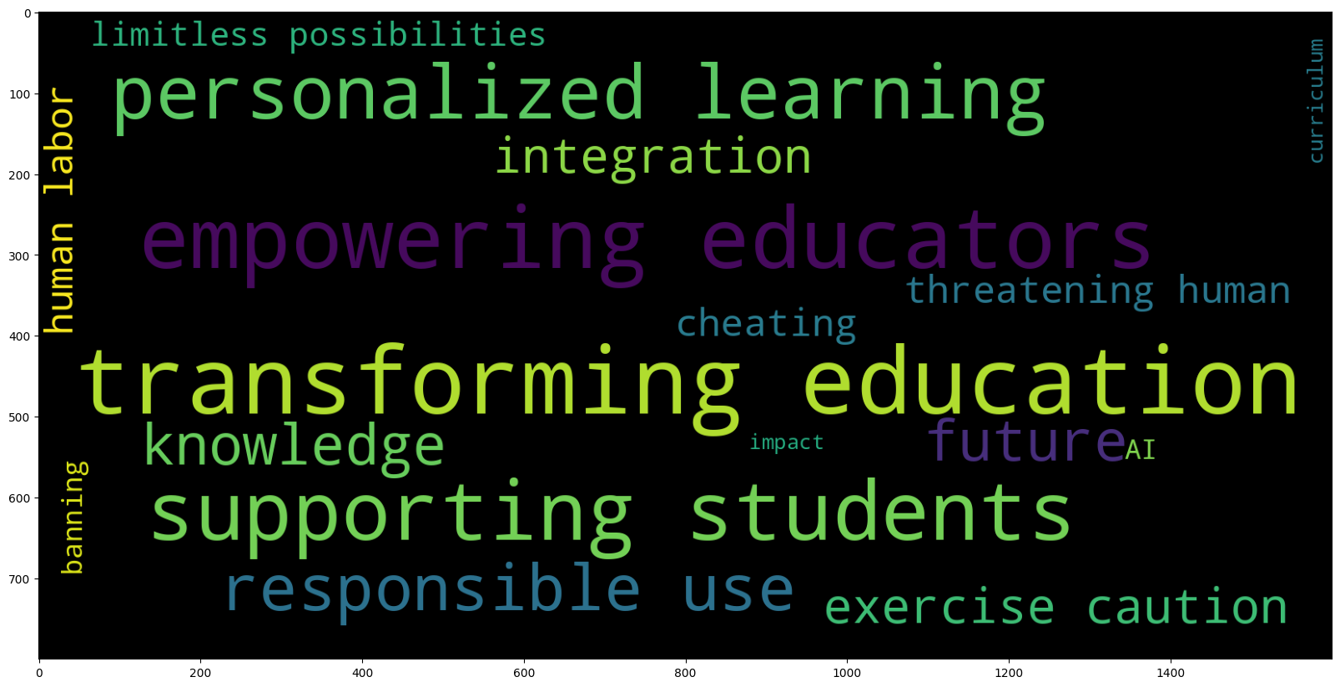

Slide 26
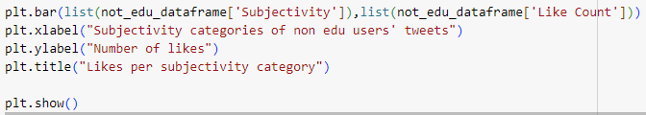
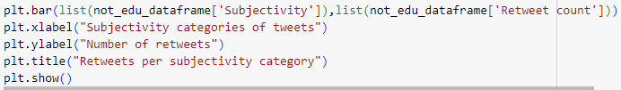
BAR GRAPHS (1)

Slide 27
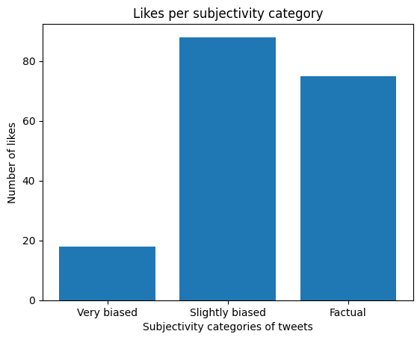
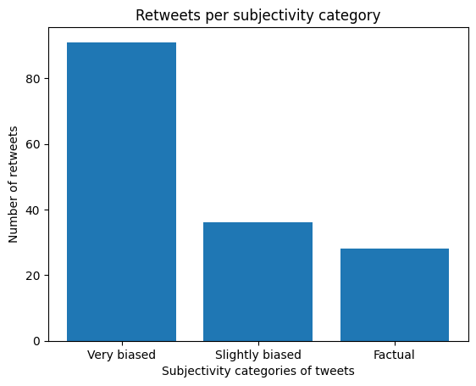
ALL: BIAS VS LIKES/RETWEETS

Slide 28
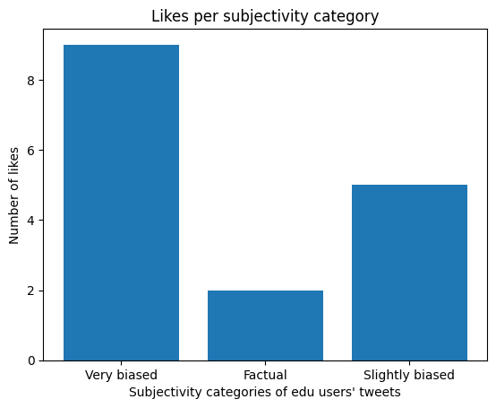
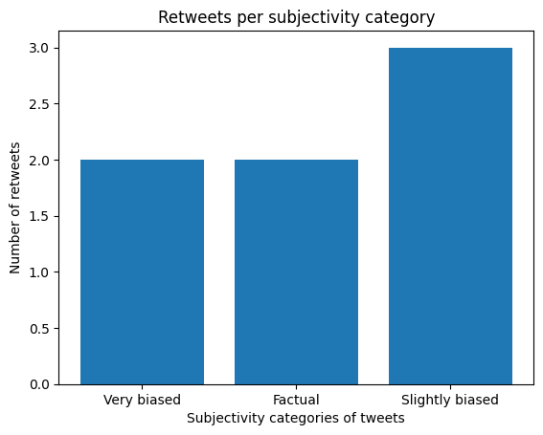
EDU: BIAS VS LIKES/RETWEETS

Slide 29

NON EDU: BIAS VS LIKES/RETWEETS

Slide 31
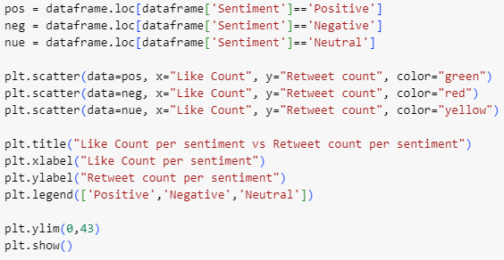
SENTIMENT ANALYSIS VS RETWEETS

Slide 32
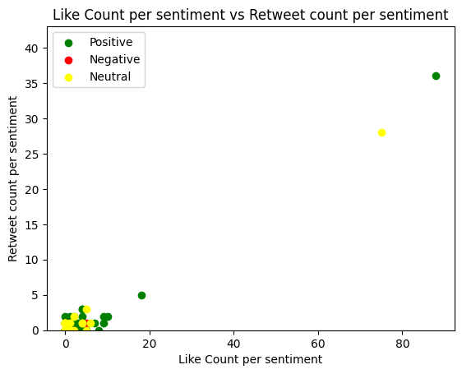

Slide 33
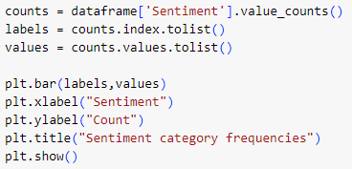
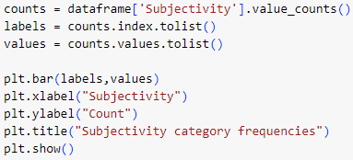
BAR GRAPHS (2) - SENTIMENT AND SUBJECTIVITY

Slide 34
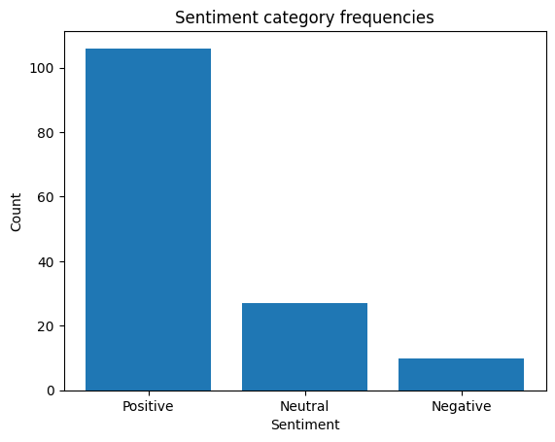

Slide 35
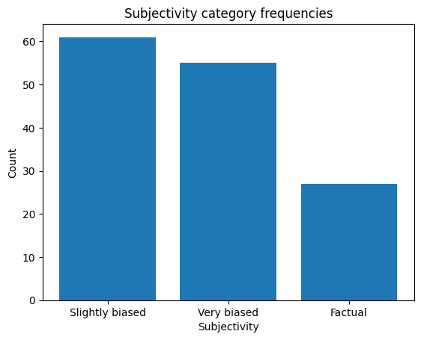

Slide 36
RESULTS - CONCLUSION
O3.

Slide 37
SUMMARY
In general, the public has positive (and slightly biased) opinions on AI in education, believing it can be used to enrich education by empowering educators, supporting students, and transforming the way we learn.
Although a prominent neutral take is that we must use AI responsibly, it doesn’t protest against the use of AI.
Surprisingly, strong ideas like banning AI and the fear of cheating were hardly mentioned.
This sentiment analysis project helps to provide reasons to politicians and school administration for why we should embrace integrating AI in education and not try suppressing it. It demonstrates how people would use AI in a good way, not just malicious ways.
My next steps would be to try and analyze data from other Twitter hashtags and branch out to other social media platforms such as Instagram, Facebook, and TikTok.

Slide 38
THANK YOU!

